Slide 1
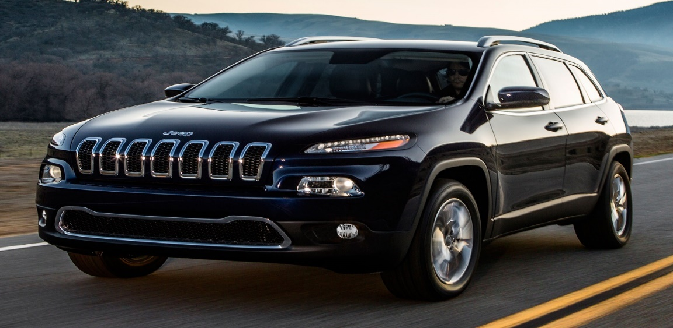




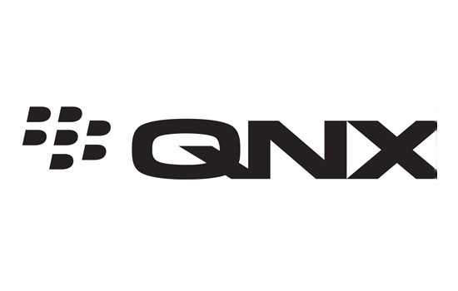

CARS CAN TALK
Though the emerging technologies fulfill our needs it also comes with huge cost, that is, our security! To test this, DARPA funded researchers, Charlie Miller, a security researcher for twitter and a former NSA hacker, and Chris Valasek, the director of vehicle security research at the consultancy IOActive tested by exploiting an auto 2014 jeep Cherokee over an internet; demonstrated to WIRED.
Vulnerabilities: The code gets running on the head unit if you have physical access with a USB stick (jailbreak) or access to the in-car Wi-Fi [1]. 2015 Jeep Hack:
They started finding the IP address/VPN of the car.
Then ran code to execute and command the D-Bus.
To look at D-Bus service they used Dfeet. And Dbus-Python for scripts/exploits[2].
Which was exposed on port 6667 running on the Uconnect 8.4AN RA4 (Harman Kardon) infotainment system (SSH the vehicle).
They used masscan to scan the internet port scanner and scanned all the vulnerable cars on sprint network in open[3].
Their telematics unit had two processors, one connected to the in-vehicle network and one connected to the internet [4].
A SPI (serial-peripheral interface) connection was required between the two processors, which allows for a variety of commands to be executed, including a firmware update [5].
To further take control they modified the v850 firmware by reverse engineer process and send messages through CAN by further sending commands to OMAP chip through the SPI and make hacking possible! [6]
They failed to hack car from long range; to cover this up they used femtocell devices (Airave 2.0),further used to communicate via D-bus over cellular network which now can hack car from any range!
After the jeep hack(2015), they disclosed the vulnerabilities and provided copies of their research to FCA, Harman/Kardon, NHTSA, and QNX .
FCA created a software update that eliminates the vulnerabilities uncovered by Miller and Valasek in their laboratory tests [7].
FCA US instituted Safety Recall 15-461 on the request of the NHTSA [8].
More effective was that Sprint blocked the IP port used to gain access to the car in the first place [9].Uconnect became stricter.
FCA’s stocks went down. But they took this seriously and positively. With that it started a bug bounty program where hackers and researchers are encouraged to find and give information on flaws of its vehicles. This made them seventh largest automaker in the world who took cybersecurity seriously.[10]
Government (NHTSA) proposed bill with few policies on automakers in ‘Automated Driving Systems 2.0: A Vision for Safety.’ FCA faced class-action lawsuit in US.
NHTSA investigated Harman Kardon who were responsible for making of Uconnect system in most auto vehicles. QNX Neutrino OS supplied by Blackberry was also held responsible for the vulnerability, but the researchers stated afterwards that the fault wasn’t from QNX.
This year NHTSA made new further policies on automated vehicles and automakers- 'Preparing for the Future of Transportation: Automated Vehicles 3.0’ (AV 3.0).
Effect on Public: Kelley Blue Book’s Blue-Ribbon Panel fielded the Vehicle Hacking Vulnerability Survey from July 24 – 27, 2015, and the survey had 1,134 respondents [11]. Following the incident the survey said that 79% respondents noted that for next three years or so, vehicle hacking would become a frequent problem. With that 81% made automakers responsible for security, followed by only 5% who thought that it was the role of the wireless provider.
Just as one cannot guarantee that the personal computers are fully secured from cyber threats, 58% think that there won't be a permanent solution to vehicle hacking if connected to internet or other cellular networks. But still 11% thought that that they should be aware and take responsibility of their own vehicle to keep from being hacked.
With that about 70% people does not trust FCA and rated as most susceptible to hacking followed by the General Motors corporation with 47% and Ford Motor company (30%).
This could be avoided :
- v850 firmware should be signed and code signing mechanism should be present.
-v850 should be kept updated by keeping in "bootrom" mode.[12]
- Uconnect should be kept separated from CAN.
- Updated Uconnect software system .
- Provide a ballistic parachute/ejection seat in case of emergencies.
- Emergency manual mode switch should be available
Tanvi Prakash Gavali
TPGavali@uclan.ac.uk
School of Physical Sciences and Computing, University of Central Lancashire

Slide 2
References
[1] Miller, C. and Valasek, C.(2015). Remote Exploitation of an Unaltered Passenger Vehicle. [PDF], pg.43. Available at: http://illmatics.com/Remote%20Car%20Hacking.pdf [Accessed 7 Nov.2018].
[2,3,12] DEFCONConference. (2015). DEF CON 22 - Charlie Miller & Chris Valasek - A Survey of Remote Automotive Attack Surfaces. [YouTube video]. Available at: https://www.youtube.com/watch?v=tnYO4U0h_wY [Accessed 17 Nov 2018]
[4,5] Evenchick, E. (2015). The Year of the Car Hacks. [online] Hackaday. Available at: https://hackaday.com/2015/09/01/the-year-of-the-car-hacks/ [Accessed 10 Nov. 2018].
[6] Miller, C. and Valasek, C.(2015). Remote Exploitation of an Unaltered Passenger Vehicle. [PDF], pg.71. Available at: http://illmatics.com/Remote%20Car%20Hacking.pdf [Accessed 7 Nov.2018].
[7] (2016). Unhacking the hacked Jeep® SUV. [online] fcanorthamerica.com. Available at: https://blog.fcanorthamerica.com/2015/07/22/unhacking-the-hacked-jeep/ [Accessed 21 Nov.2018]
[8] Case 3:15-cv-00855 Document 1 Filed 08/04/15 Page 6 of 42 Page ID #6, In The United States District Court For The Southern District Of Illinois. [online] Scribd. Available at: https://www.scribd.com/document/273558697/FCA-Harman-Complaint#fullscreen&from_embed [Accessed 21 Nov.2018]
[9] Schneider, D. (2015). Jeep Hacking 101. [online] Spectrum. Available at: https://spectrum.ieee.org/cars-that-think/transportation/systems/jeep-hacking-101 [Accessed 21 Nov 2018]
[10] AUBURN HILLS, Mich.,(2016). FCA US Launches Bug Bounty Program to Advance Vehicle Cybersecurity. [online] Paladin Capital Group. Available at: https://www.paladincapgroup.com/fca-us-launches-bug-bounty-program-to-advance-vehicle-cybersecurity/ [Accessed 23 Nov 2018]
[11] Jonston, B. (2015). After media blitz – awareness of car hacking high, survey says. [online] autoconnectedcar . Available at: http://www.autoconnectedcar.com/2015/07/after-media-blitz-awareness-of-car-hacking-high-survey-says/ [Accessed 17 Nov.2018]
The 2014 Jeep Cherokee image- https://enthusiastnetwork.s3.amazonaws.com/uploads/sites/5/2013/06/2014-Jeep-Cherokee-front-three-quarter-motion.jpg?impolicy=entryimage
Uconnect image - https://blog.fcanorthamerica.com/wp-content/uploads/2016/01/Uconnect-logo-square.png
FCA image http://www.uaw-chrysler.com/wp-content/uploads/2016/01/FCA-logo2.jpg
WIFI image- https://www.universfreebox.com/UserFiles/image/wifi(1).png
NHTSA image- http://bestride.com/wp-content/uploads/2016/01/NHTSA-Logo.png
Harman Kardon image - http://mb.cision.com/Public/12339/2069646/87d1fcc08896bd83_org.png
QNX image - https://www.unmannedsystemstechnology.com/wp-content/uploads/2015/02/QNX-Logo.jpg

